Slide 1
Cache Memory
Baiqiang Wen
Norman Tang
Chenwei Cao

Slide 2
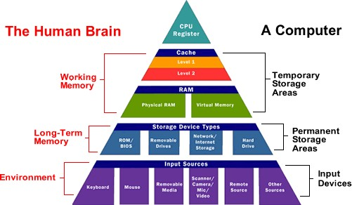

Slide 3
What is cache memory?

Slide 4
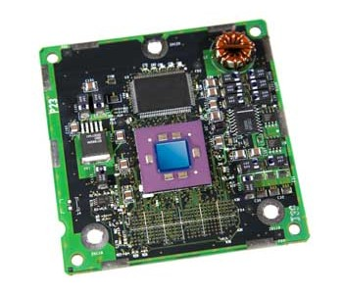
1. Cache memory is a small-sized type of volatile computer memory

Slide 5
Cache memory is asmall-sized type of volatile computer memory
Cache is cheaper
Cache memory is a very high speed memory
Cache is used to reduce the average time to access data from the main memory

Slide 6


Slide 7
1968 C.J. Conti introduced cache when he describe the difference between the system 360/85 and 360/91
The 68010, released in 1982, has a "loop mode" which can be considered a tiny and special-case instruction cache that accelerates loops that consist of only two instructions. The 68020, released in 1984, replaced that with a typical instruction cache of 256 bytes, being the first 68k series processor to feature true on-chip cache memory.

Slide 8
The 68030, released in 1987, is basically a 68020 core with an additional 256-byte data cache, a process shrink, and added burst mode for the caches.
The 68040, released in 1990, has split instruction and data caches of four kilobytes each.
The 68060, released in 1994, has the following: 8 KB data cache (four-way associative), 8 KB instruction cache (four-way associative), 96-byte FIFO instruction buffer, 256-entry branch cache, and 64-entry address translation cache MMU buffer (four-way associative).

Slide 9
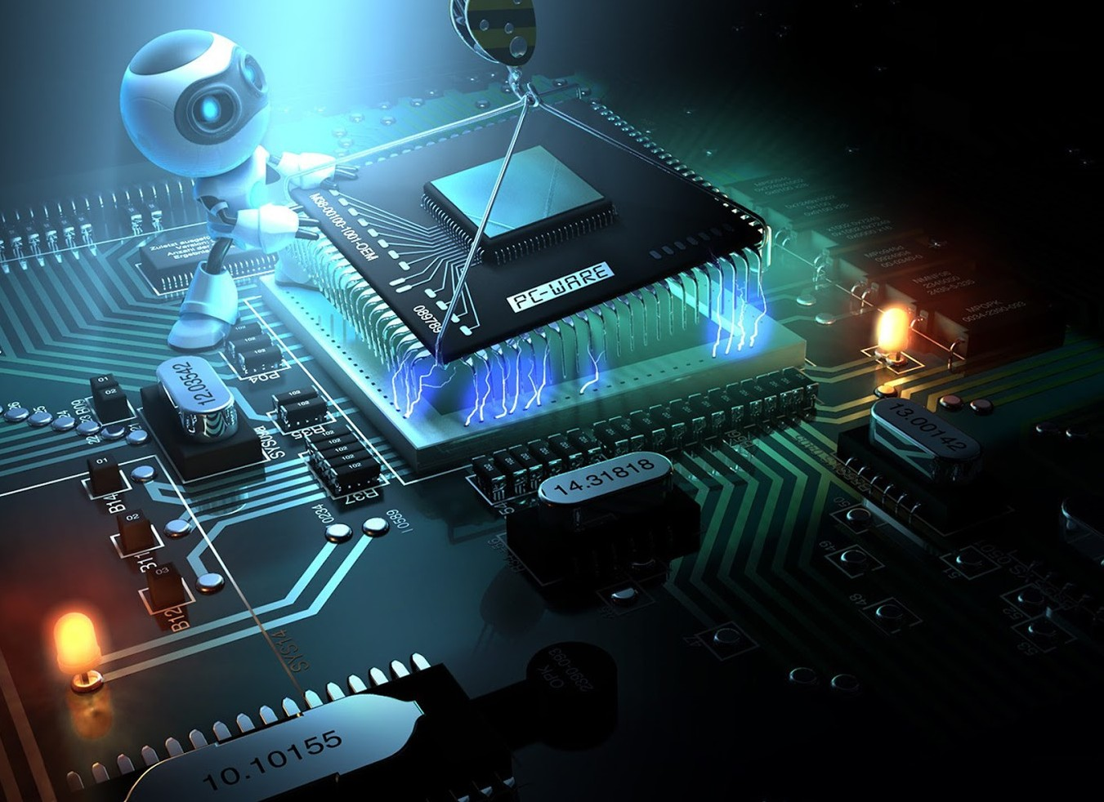
Future

Slide 10
Early cache designs focused entirely on the direct cost of cache and RAM and average execution speed.
More recent cache designs also consider energy efficiency, fault tolerance, and other goals.
Researchers have also explored use of emerging memory technologies such as eDRAM (embedded DRAM) and NVRAM (non-volatile RAM) for designing caches.

Slide 11
Multi-ported cache
A multi-ported cache is a cache which can serve more than one request at a time.
When accessing a traditional cache we normally use a single memory address, whereas in a multi-ported cache we may request N addresses at a time
The benefit of this is that a pipelined processor may access memory from different phases in its pipeline. Another benefit is that it allows the concept of super-scalar processors through different cache levels.

Slide 12
Levels of Memory

Slide 13
Levels of Memory

Slide 14
Levels of Memory

Slide 15
Levels of Memory

Slide 16
Cache Performance

Slide 17
Cache Performance

Slide 18
Cache Performance

Slide 19
Cache Performance

Slide 20
Cache Mapping

Slide 21
Cache Performance

Slide 22
Cache Performance

Slide 23
Cache Performance

Slide 24
Cache Performance

